Slide 1

Muhammadiyah Australia College
expansion project Update

Slide 2
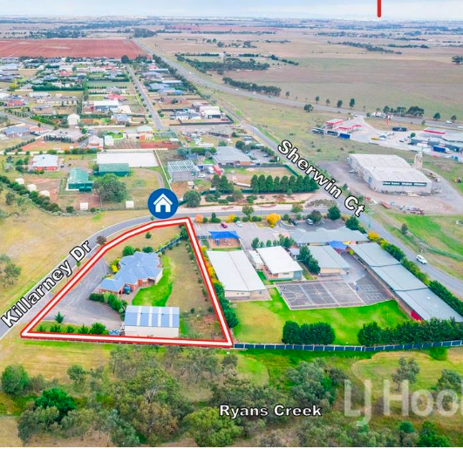
Government Grant Boosts Expansion
Substantial Government Support
A government grant of approximately $3.6 million AUD is allocated to support the expansion of the college, reflecting a significant commitment to education.
Upgraded College Infrastructure
This funding enables Muhammadiyah Australia College to enhance its facilities, providing an improved setting for student learning.
Progressive Implementation
The College expansion will be done in stages, and this grant approval is only for Stage 1 of the project

Slide 3
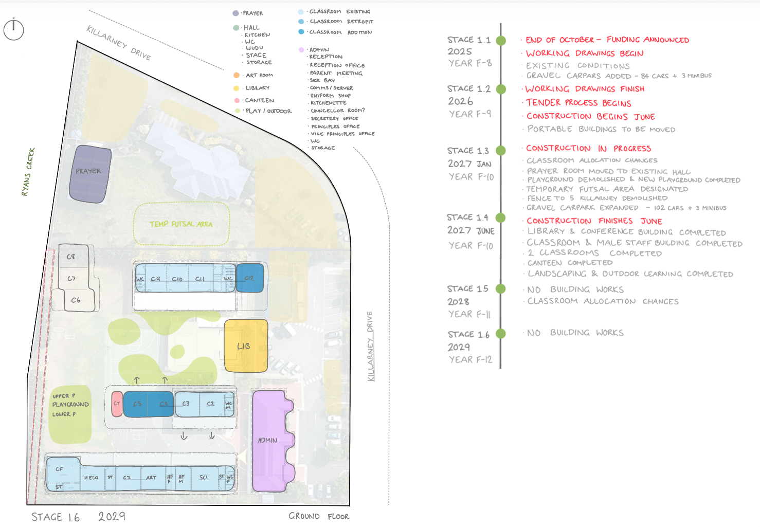
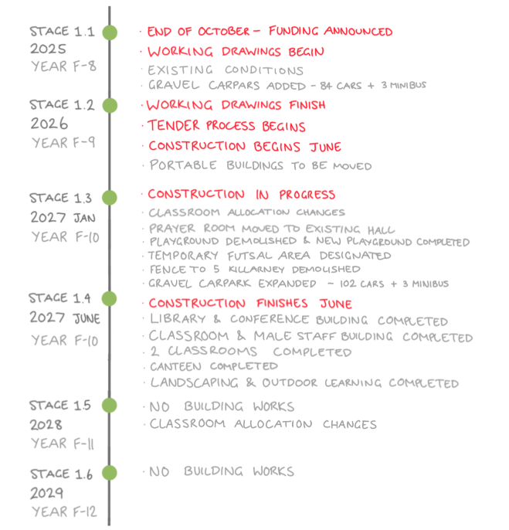

Slide 4
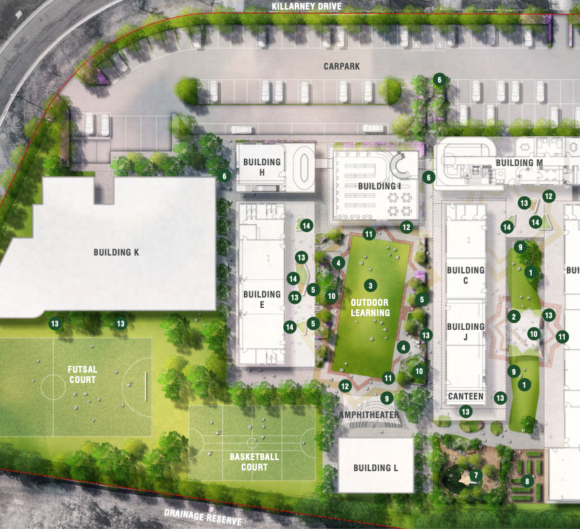
Graphic depicting the finished stages
Sustainable Construction and Landscaping Strategy
Extensive green landscaping to enhance environmental quality
Use of eco-friendly materials to reduce impact
Improved energy efficiency through strategic planning and smart technology
Incorporation of renewable energy technologies such as solar panels
Enhanced insulation to conserve energy
Maximising natural light and airflow
Minimising construction waste
Maintaining a healthy indoor and outdoor environment for both students and staff

Slide 5
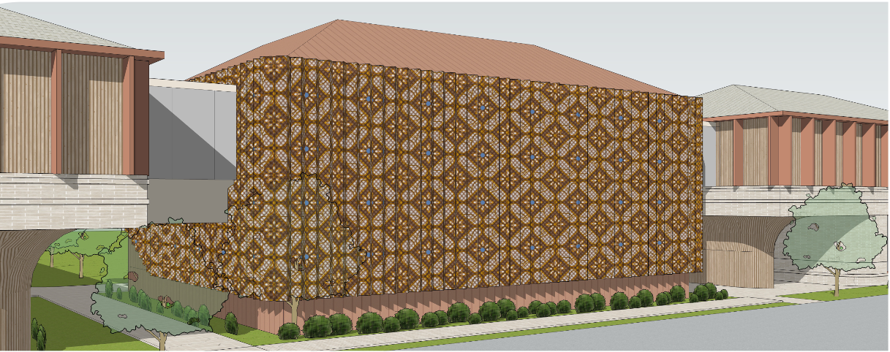
Batik Motif Facade
Stage 1 focuses on constructing the library and conference room building, which will be the centrepiece of our new school design. The building's facade is adorned with a batik-inspired pattern, thoughtfully integrated to reflect Indonesian cultural heritage and the identity of Muhammadiyah, creating a distinctive and meaningful architectural statement.

Slide 6
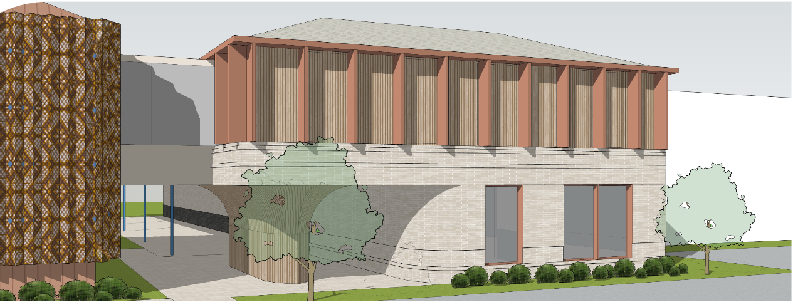
Construction of the Male Staff Room Building
The Male Staff Room Building is scheduled for construction during Stage 1, situated on the current playground site. A first-floor walkway will connect it to the Conference Room/Library Building, offering an aesthetically pleasing elevated link. Furthermore, the building will incorporate a classroom on the ground floor.

Slide 7
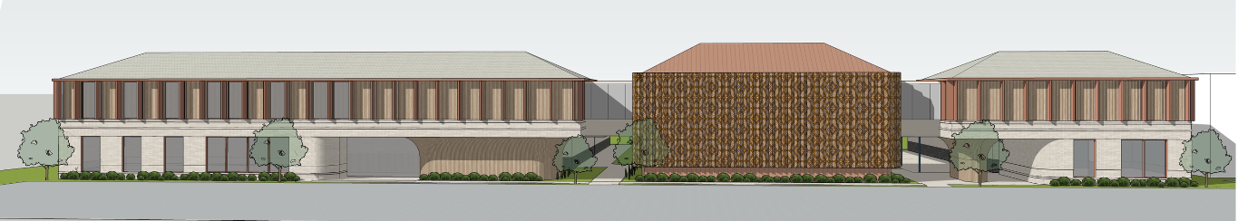
Upcoming Developments
Phase 2 of the project will involve:
Upgrading the Administrative Building into a two-storey facility, which will be connected to the conference hall via a link bridge.
Building a Multipurpose Hall adjacent to a new Musollah.
Creating a permanent outdoor Futsal court.
Identifying a new site for our Secondary village to accommodate Grades 7 through 12, while the current campus will continue to serve Foundation to Grade 6

